Slide 1
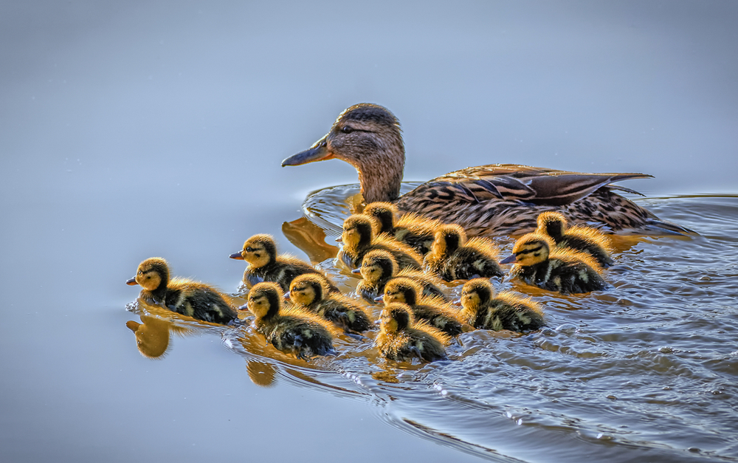
Welcome to Duckling Class’
Parent Meeting

Slide 2


Slide 3
The Pupil Premium Grant
At Bramber, our intent is that all pupils, irrespective of their background or the challenges they face, make good progress and achieve high attainment across the curriculum. Pupil Premium funding helps remove barriers to learning and enables our disadvantaged and vulnerable pupils to fully engage in our curriculum and school life.

Slide 4
We are given pupil premium funding for:
Children in Reception to Year 6 who are currently entitled to free school meals based on their family income.
Children in Reception to Year 6 who were previously entitle to benefits-based free school meals, even if they are no longer eligible.
Children cared for.
Previously looked after children who have been adopted, have a special guardianship order, a child arrangement order or a residence order.
Children recorded as being from services families.

Slide 5
Pupil Premium Spending….
Additional resources to support learning at home and school
Support for trips and experiences
School Uniform
Pastoral care and well being
Staff training
Additional staff
Please read our three-year strategy on the website.

Slide 6
We will talk about:
An insight into your child’s first year at school
The EYFS curriculum – prime & specific areas of learning
Approaches to teaching Reading, Writing & Number
Any queries

Slide 7
Adults working with your child
Class Teachers: Mrs Holmes & Miss Barber PPA Cover: Mrs Poole
Class Teaching Assistant: Miss Kirin
Student: Miss Alderman (Mon & Tues)

Slide 8
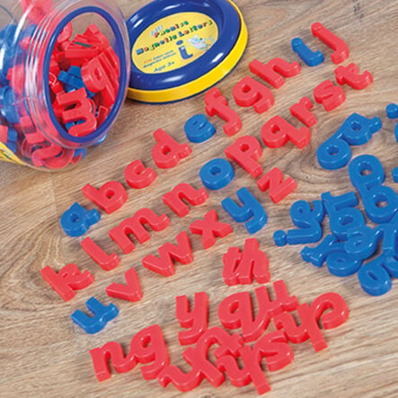
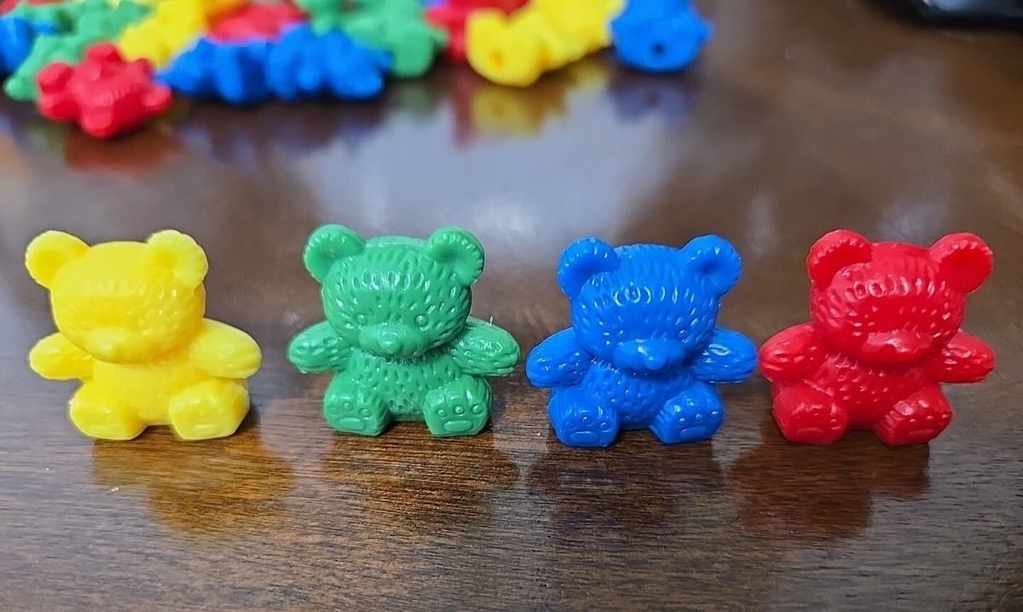
Baseline Assessment
The reception baseline assessment provides the basis for a new way of measuring the progress primary schools make with their pupils. Unlike the previous progress measure, this will give schools credit for the important work they do with their pupils between reception and year 6.
Your child has completed two activities which involve number and communication and literacy skills.

Slide 9
The Early Years Foundation Stage
3 Prime Areas:
Communication and Language:
Listening, Attention and Understanding
Speaking
Physical Development:
Gross Motor Skills
Fine Motor Skills
Personal, Social and Emotional Development:
Self-Regulation
Managing Self
Building Relationships

Slide 10

Communication and Language
“There is strong evidence that teaching and modelling vocabulary to children in the early years can have a positive effect on their oral language skills”.
Books, books, books!
Tales Toolkit
“Her throwed the ball!”
“Yes, she threw that colourful ball over the fence!”
Meaningful conversations
Recasting sentences
Source: Approaches for supporting communication and language development Teaching and Modelling Language, EEF evidence store.

Slide 11
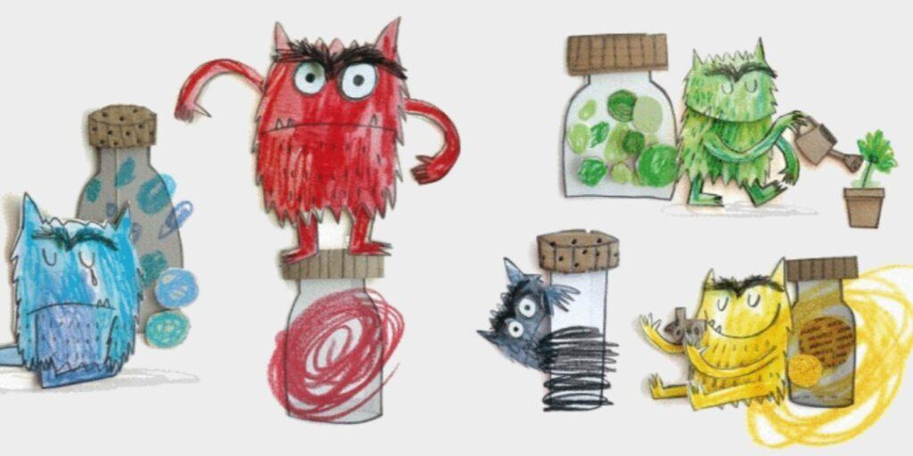
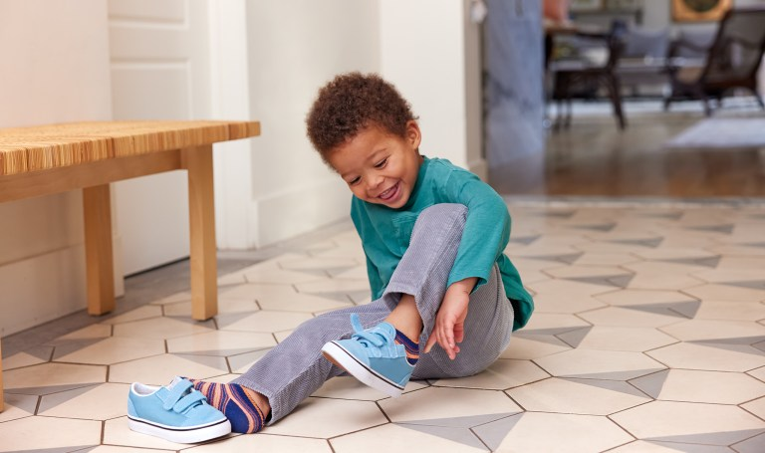
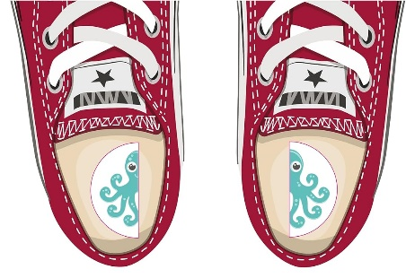
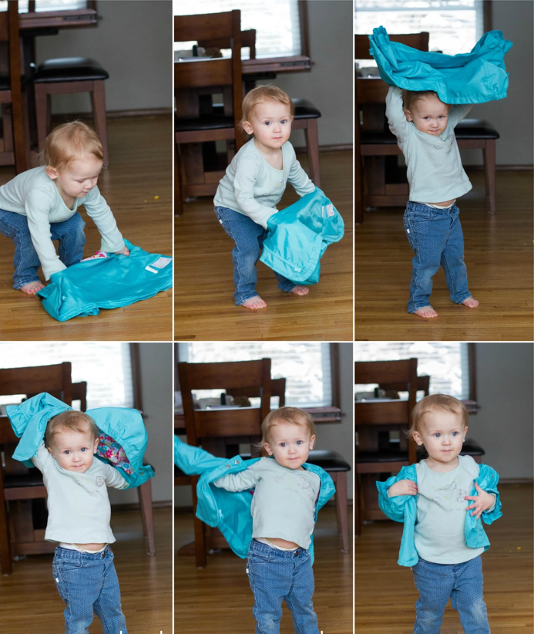
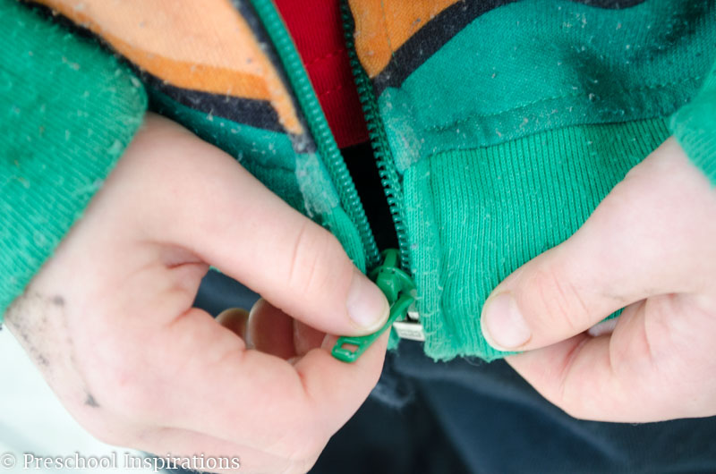
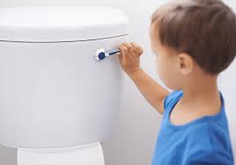
Personal, Social and Emotional Development
Independence with dressing
Emotions
Toileting Independence

Slide 12
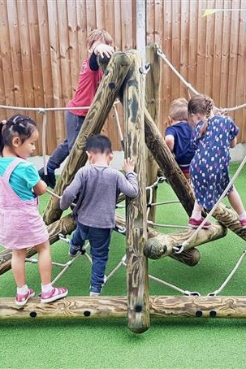
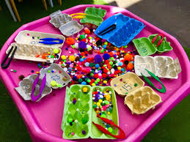
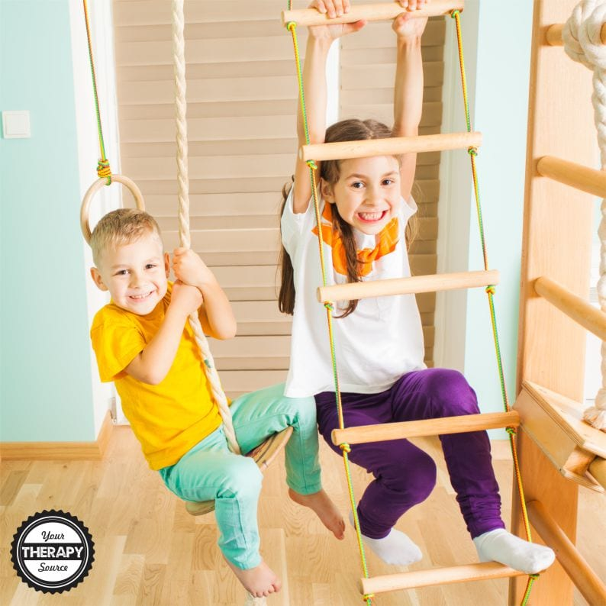
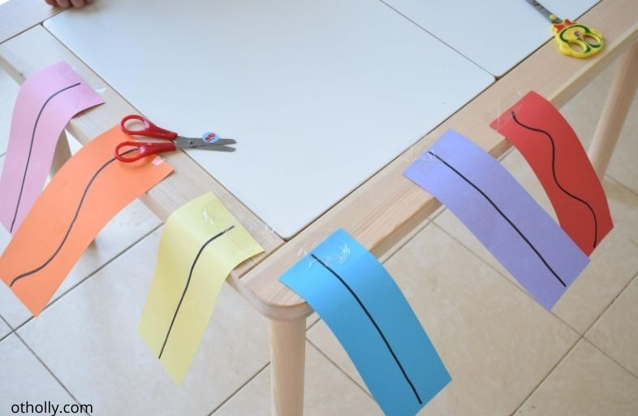
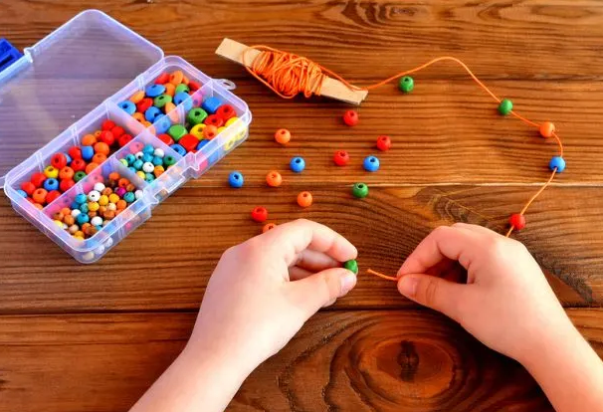

Physical Development
Gross motor Development
Fine motor skills

Slide 13
Easy ways to support your child’s physical development:
Playdough or clay: Squeeze, roll, pinch, and press playdough to build hand and finger strength.
Lego and contruction
Kitchen Helpers: Peel satsumas or bananas, tear lettuce, stir batter, or use child-safe tongs to transfer small snacks, open and close containers; spread butter onto toast.
Helpful hands: Hang up the washing or sort socks into pairs.
Scissors and Paper: Practice cutting paper, straws, or old junk mail with safety scissors, or tear paper into small confetti pieces. Make pictures and cards using scissors. Cut string for projects and crafts.
Independent dressing: Practice buttoning tops, zipping coats, buckling shoes.

Slide 14
The Early Years Foundation Stage:
4 Specific Areas:
Literacy
Comprehension
Word Reading
Writing
Mathematics
Number
Numerical Patterns
Understanding The World
Past and Present
People, Culture and Communities
The Natural World
Expressive Arts and Design
Creating with Materials
Being Imaginative and Expressive

Slide 15
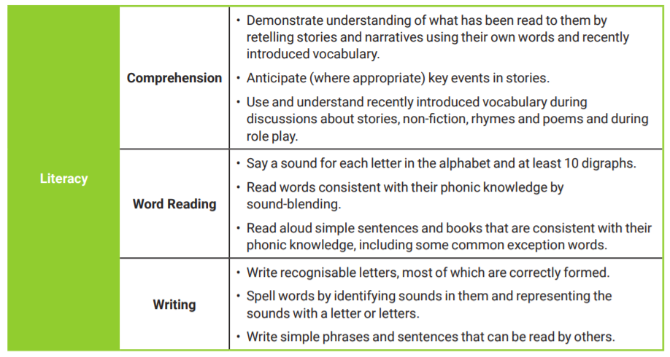
By the end of the Reception year (ELG):

Slide 16
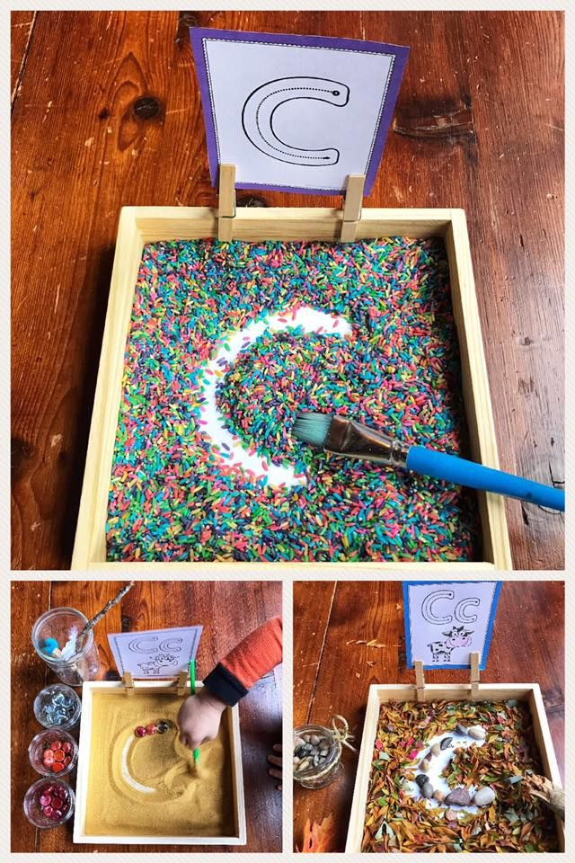
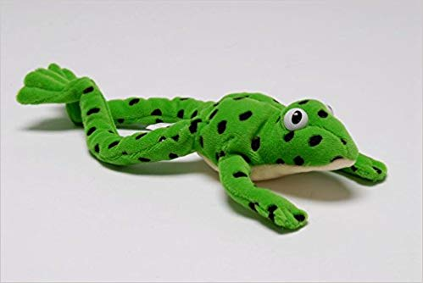
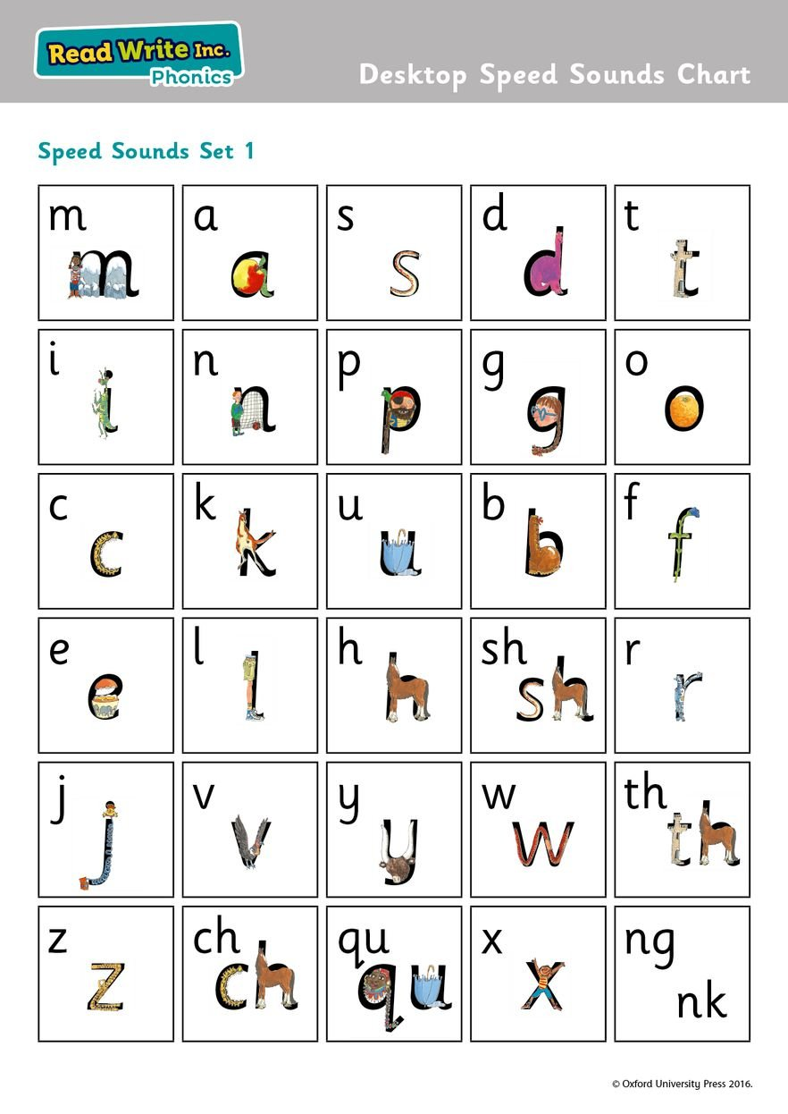
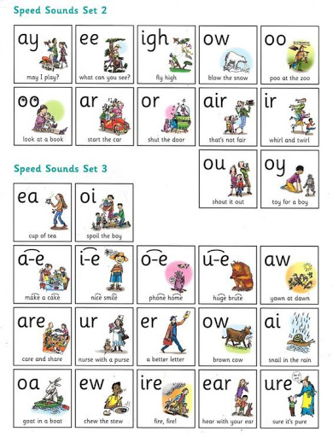
Phonics – Read Write Inc.
Oxford Owl Website:
https://home.oxfordowl.co.uk/reading/reading-schemes-oxford-levels/read-write-inc-phonics-guide/

Slide 17
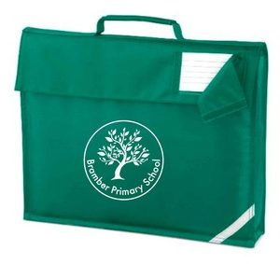
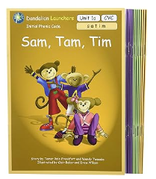
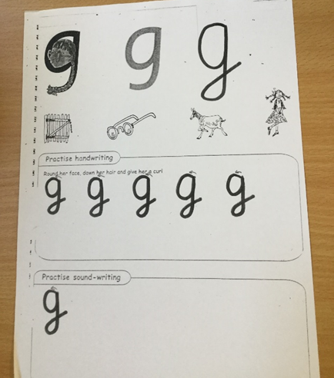
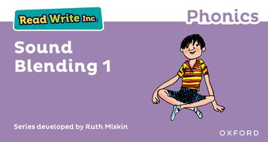
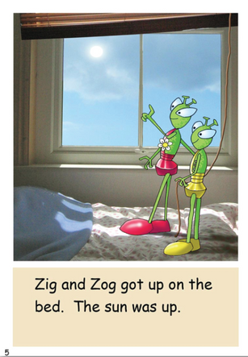
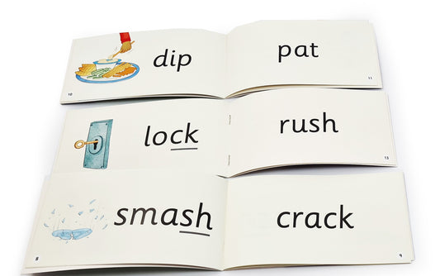

Your child will be bringing home
Letter formation and later in the term - ditty sheets to practise and apply phonic learning
A picture book from the library for you to read to your child to encourage good reading habits and the joy of reading!
Phonics reading books to
apply their
phonics learning

Slide 18

“Regularly reading to a child for the love of it provides a connection between parent and child from the very early days and helps build strong family ties. Families who enjoy reading together have more opportunities for discussion, developing empathy and attachment. Reading to their infant is one of the greatest gifts parents can give.
By starting the journey of building a lifelong love of reading for pleasure, parents are giving their child the opportunity to be the best they can be: children who read for pleasure do better in a wide range of subjects at school and it also positively impacts children’s wellbeing.”
National Literacy Trust

Slide 19
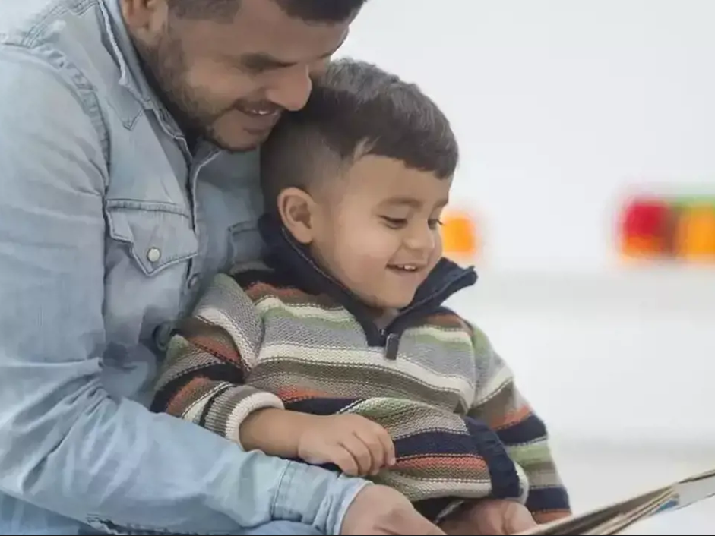
Reading, vocabulary, and the 'million-word gap'
A study by The Ohio State University found a 'million-word gap' between the young children who are read to at home, and those who aren't.
Once the calculations were in, researchers found that children who were:
Never or barely read to, heard 4,662 words by the age of five
Read to once or twice a week, heard 63,570 words
Read to three to five times a week heard 169,520 words
Read to daily heard 296,660 words
Read five books a day heard an impressive 1,483,300 words
As such, this study discovered not just a million-word gap, but a 1,478,638 word gap between children who grow up in a 'literacy-rich environment' and those in less book-ish households.

Slide 20

Easy ways to support your child’s reading at home:
Listen to your child read every day if possible, even just for five minutes. It really will make a difference. If your child gets stuck on a word, model how to say the sounds and blend them together.
Visit the local library regularly and try and read a picture book to your child every day if possible. Including stories as part of your bedtime routine is ideal. Talk about what is happening and ask your child questions as you read. Explain any unfamiliar words and try and use them again to support your child’s understanding.

Slide 21






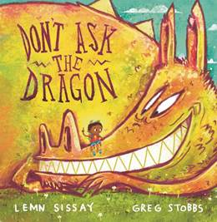
www.booktrust.org.uk
What to read after your favourites | BookTrust

Slide 22
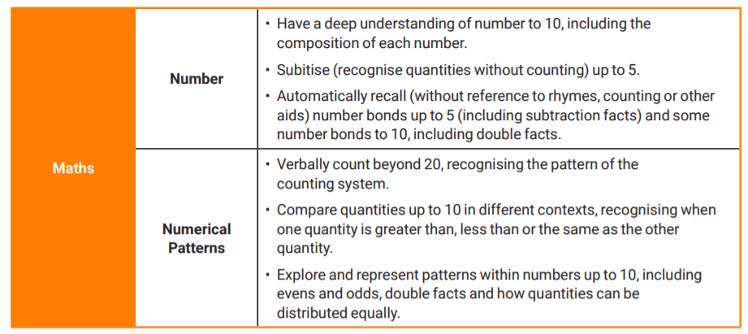
By the end of the Reception year: (ELG)

Slide 23

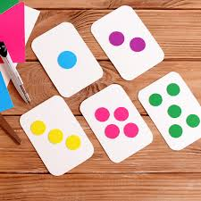
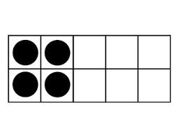

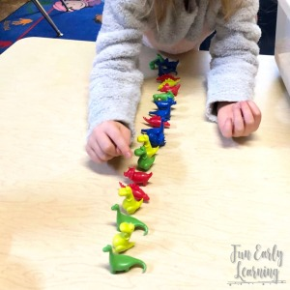
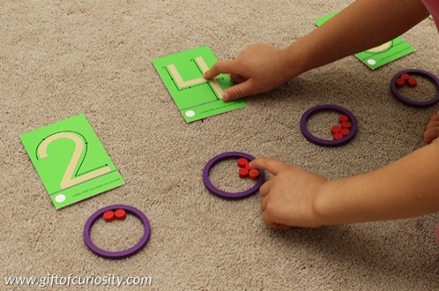
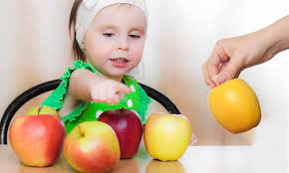
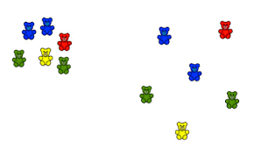
Counting: saying number words in sequence
Subitising: recognising small quantities without needing to count them all
Counting: tagging each object with one number word
Numeral meanings:
Counting: knowing the last number counted gives the total so far
Conservation: knowing that the number does not change if things are rearranged (as long as none have been added or taken away)

Slide 24

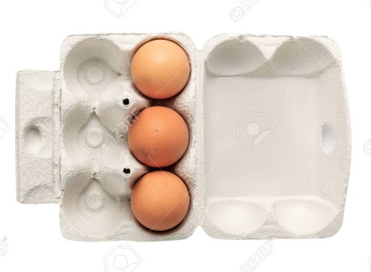

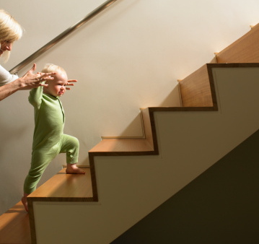
A few ways to support your child’s learning in Maths at home:
Point out and name any numerals you see when you are out and about or at home and encourage your child to do the same.
Provide lots of opportunities to say how many things you can see (up to 5) without counting.
Whenever you talk about a small set of objects, say the number. For example, please pick up those 3 teddies or look at those 2 dogs.
Count up (starting from one) when walking upstairs and count back when walking downstairs.

Slide 25
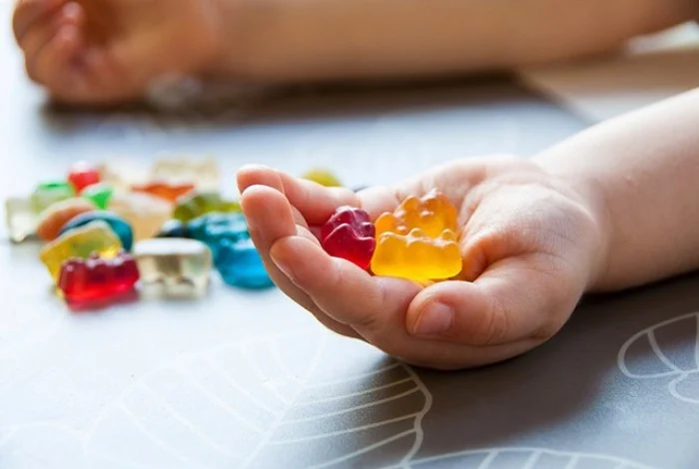
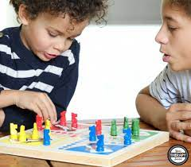
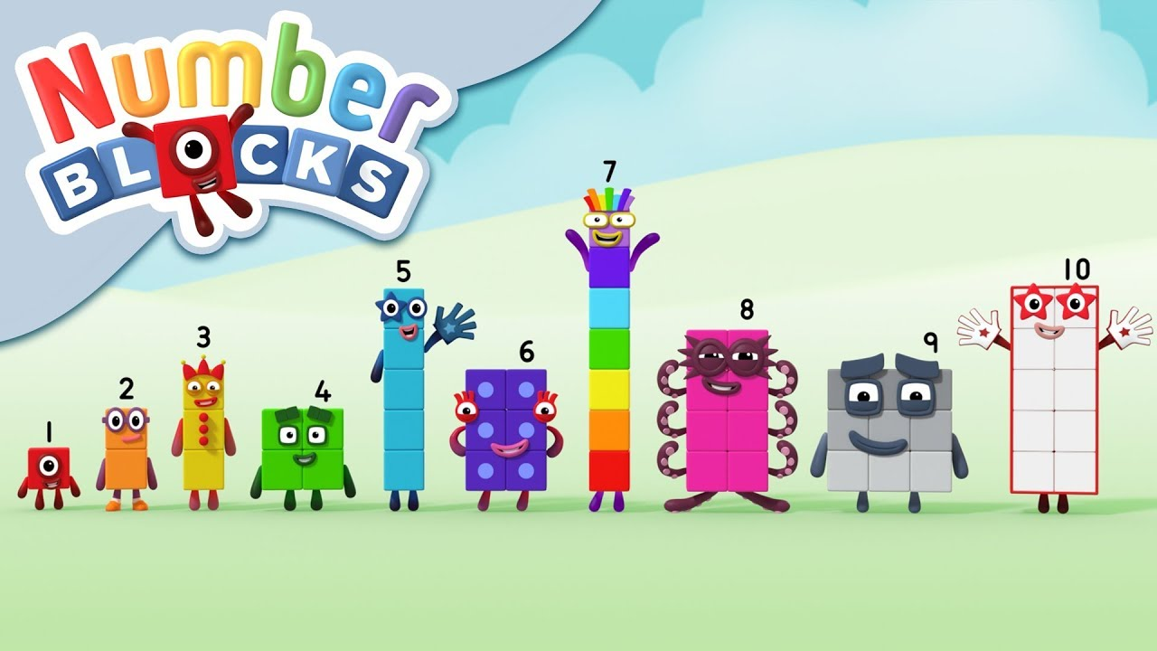
A few ways to support your child’s learning in Maths at home cont:
Count lots of different objects, big and small, and ask ‘How many are there?’ Your child should be able to tell you without going back and re-counting. If they can’t, then tell them: ‘There are 6 altogether’.
Play board games with your child which involve moving along numbered tracks, such as ‘Snakes and Ladders’. Check that your child counts along the track correctly, moving one square for each number counted.
Watch number blocks with your child and ask your child what they noticed.

Slide 26
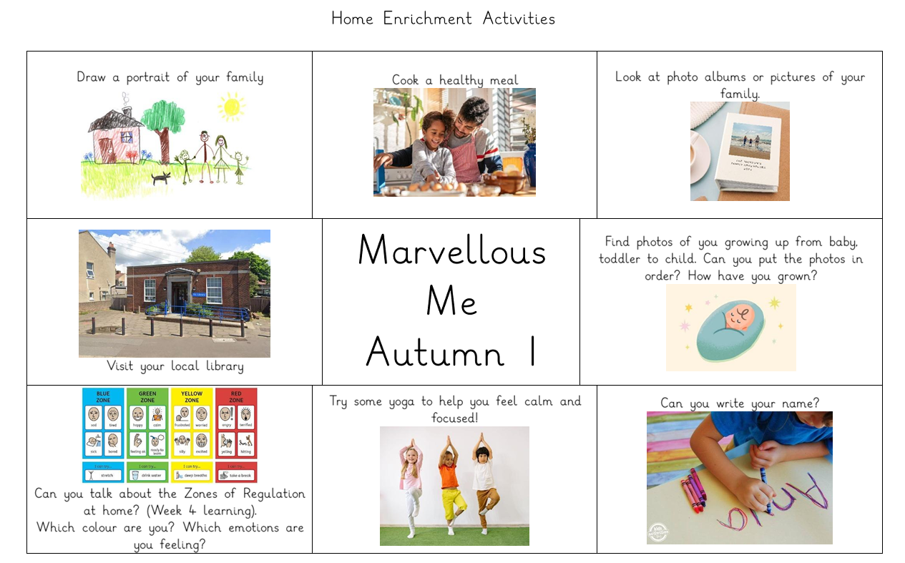

Slide 27
Playful Learning
The opportunity for your child to learn through their play
“The goal of early childhood education should be to activate the child’s own natural desire to learn.”
Maria Montessori

Slide 28
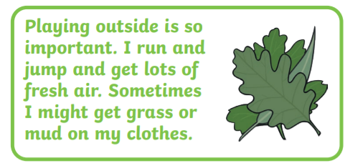
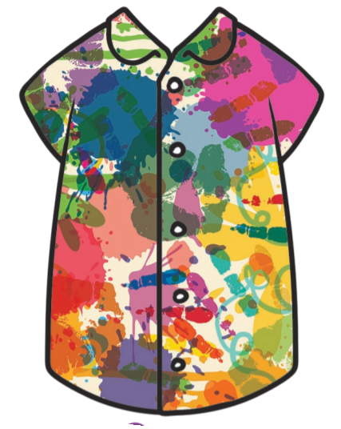
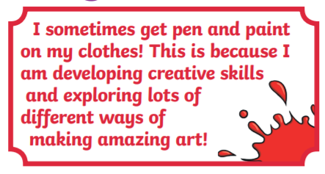
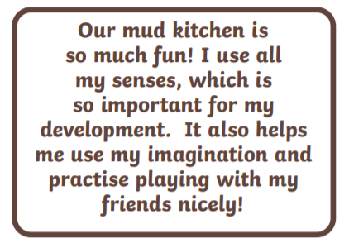
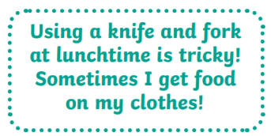
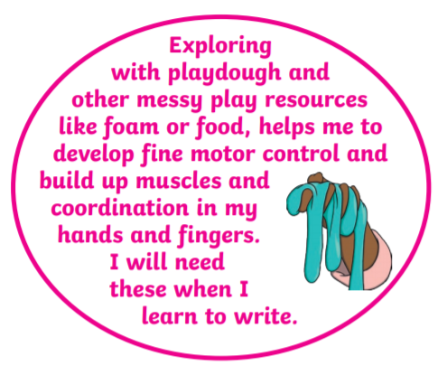
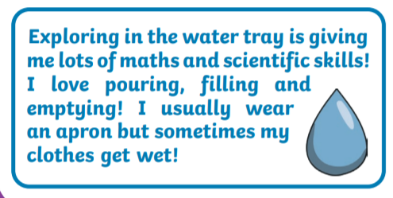
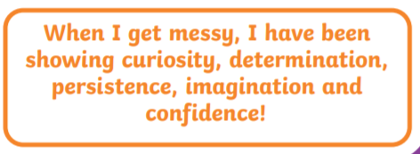
Learning can be MESSY!

Slide 29
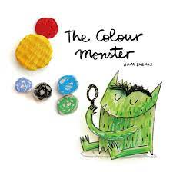

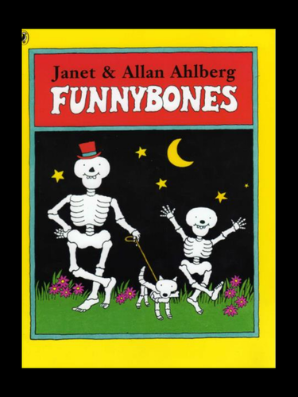





Topic based learning
Autumn 1: Marvellous me!

Slide 30







What’s coming next?
Let’s Celebrate!

Slide 31

Sharing your child’s learning experience…
Tapestry: Observations will be uploaded for you to see what your child has been learning in school.
Bramber Primary School website: The class blog will be regularly updated with information regarding the duckling’s learning.
Parent consultations: Tuesday 3rd and Thurs 5th November. A ten minute appointment to discuss your child’s learning journey so far.
End of term ‘curriculum open day’: a chance to visit the classroom and see your child’s learning journal.

Slide 32
Information overload!
Don’t forget to check our class web page regularly
Please continue to…
Encourage your child in all aspects of learning – From the courage to try something new to attempting to form letters in their name
Please come & ask if there are any questions ☺

