Slide 1
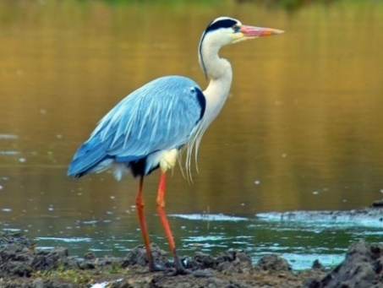
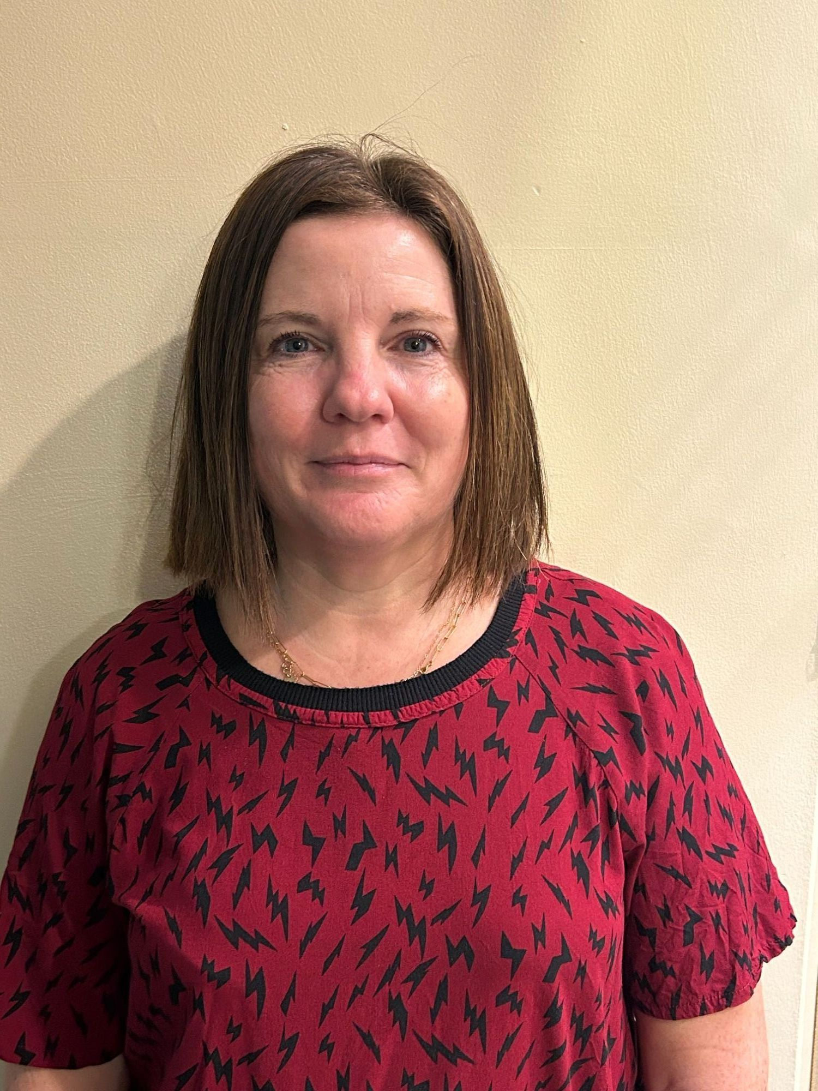
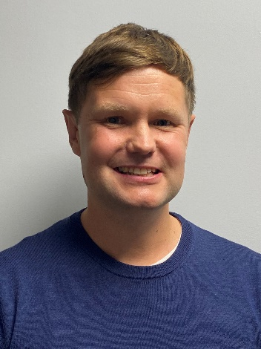
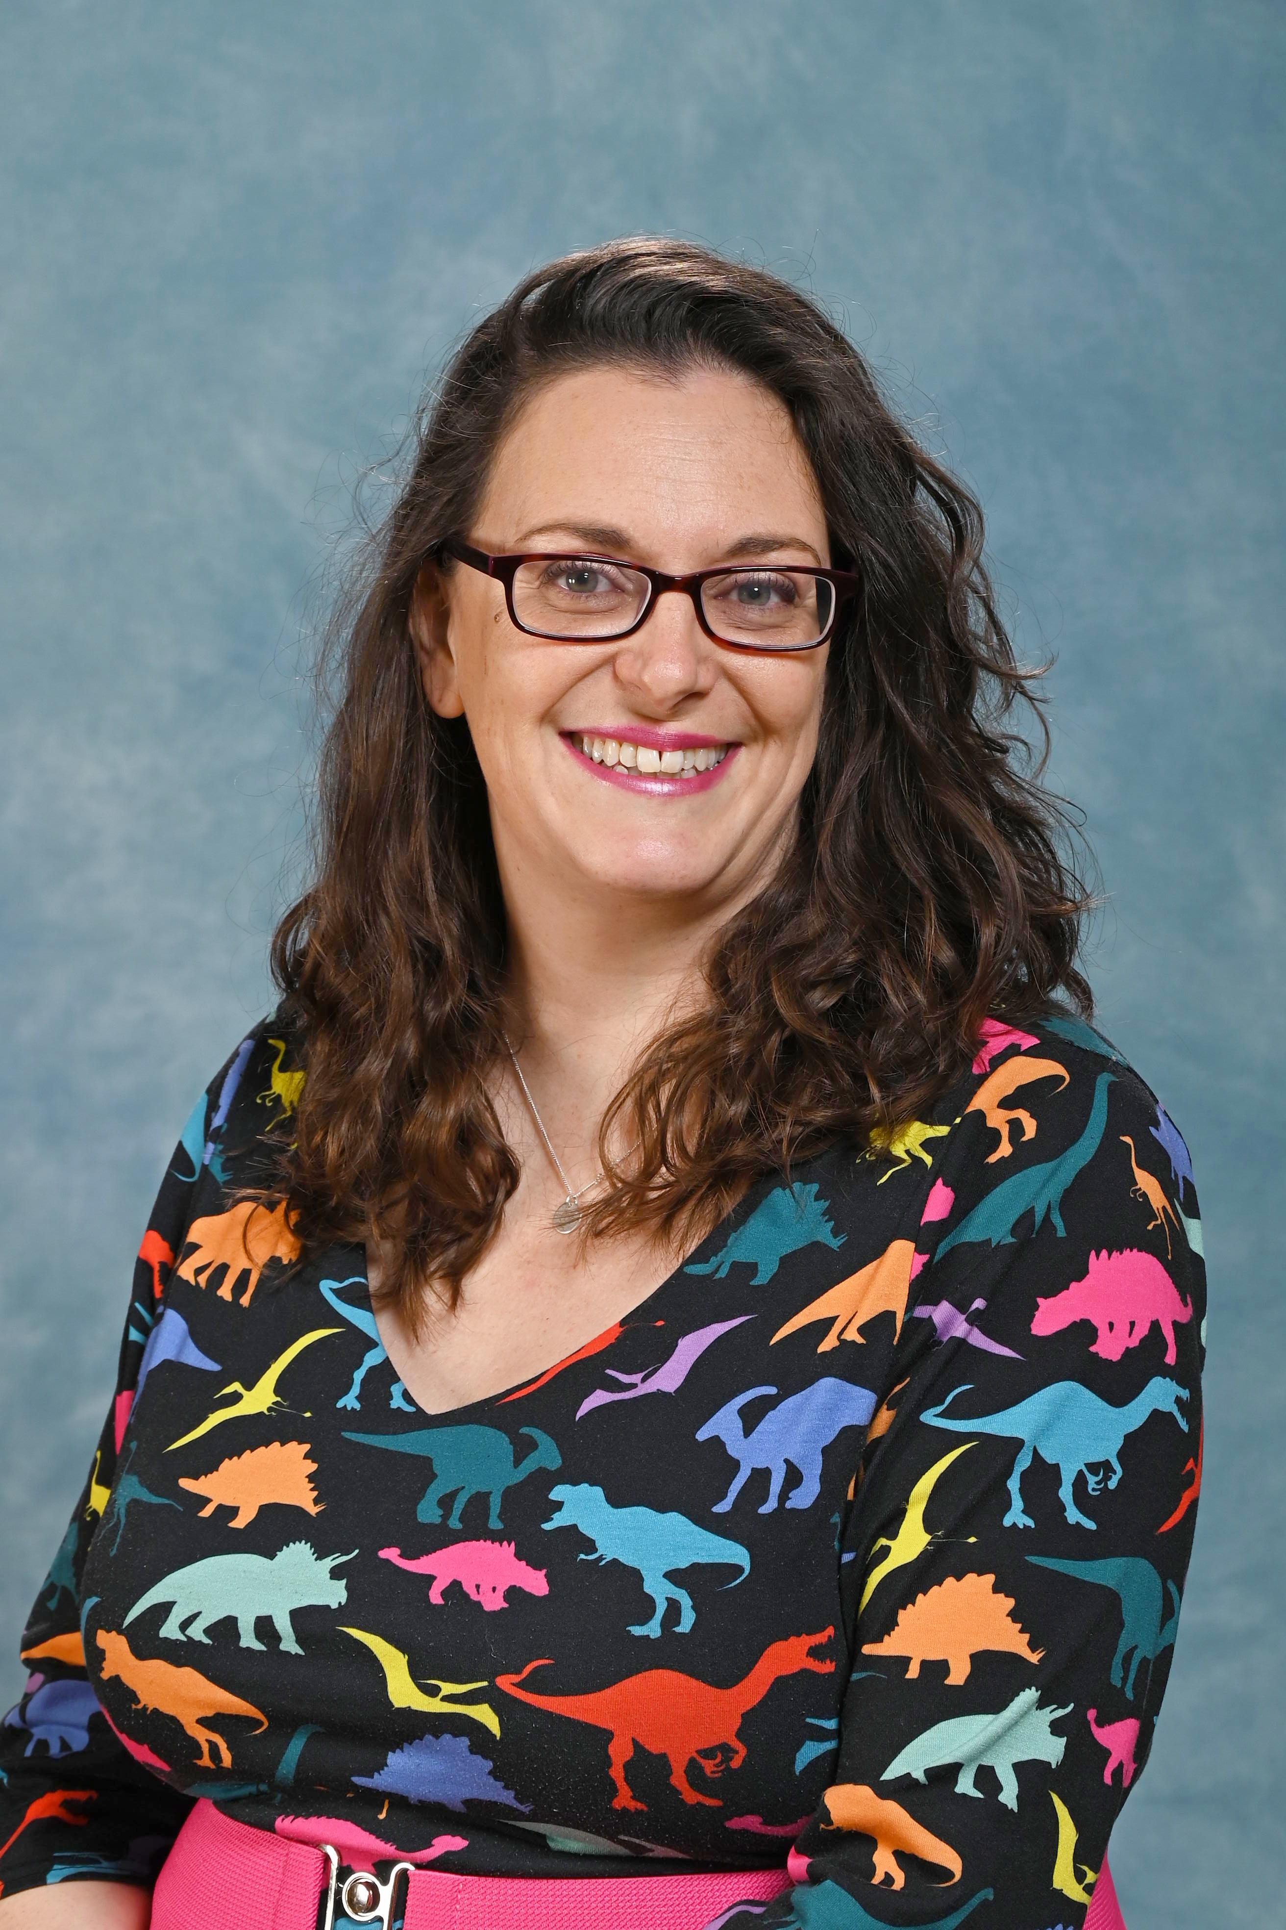
Welcome to Year 6
Class name: Heron
Teachers: Mr Pugh and Miss Rhine
Teaching Assistant:
Miss Tanner

Slide 2
Roles and Responsibilities.
Lead Learners:
House Captains:
Parham:
Goodwood:
Petworth:
Stansted:
Legacy Leaders:
School Councillors:
Reception Helpers:
Art Ambassadors:
Hall Monitors:
Eco Committee:
Digi Leaders
Notes:
Other jobs after xmas

Slide 3
Key Information
Bikeability –
Transitions and applications for Secondary School
Please inform the office of any visits during school time.
Applications for Secondary Schools by Saturday 31st October 2026.
(Applications are dealt with by the Secondary Schools/High schools and the local authority)
Keeping Safe online
Social media - use advised age rating. Please monitor what they are searching and the messages they send to each other.
Age appropriate gaming
Mobile phones – if children have permission to walk to/from school alone, they can be brought into school but must be switched off before they enter the premises. They will then stay in the office which is locked throughout the day. They can turn them on when they have left the school premises.
Notes:
Transitions – ring office in advance
Mobile protocol
Use of social media – keeping safe
Permission slips
Home learning optional. It is ARE and practice of skills that have been taught that week. Awarding hard work. If children find the learning challenging, attempt what they can and record in planner what they have completed.

Slide 4
Key Information
Developing Independence
Walking to and from home without an adult. The school day starts at 8:40. Children are marked as late if they arrive from 8:50.
Class and whole school jobs.
Changing home spaces
Home learning. Homework will be set on Thursday and will include spelling, reading and maths work.
At least 15 minutes daily reading – Accelerated Reader books, books from home and library books
Learning to spell Year 5 and 6 words and learning and applying spelling rules. A weekly spelling list will be sent home to help with this.
Learning and consolidation of times tables (using TT Rockstars or times tables sheets they may take home).
Termly creative tasks, linked to topic learning.
PE
Outdoor and indoor kit on PE days (Mondays and Thursdays). Please remember hair tied or pinned back, no earrings, short nails and a jumper in colder weather.
Notes:
Transitions – ring office in advance
Mobile protocol
Use of social media – keeping safe
Permission slips
Home learning optional. It is ARE and practice of skills that have been taught that week. Awarding hard work. If children find the learning challenging, attempt what they can and record in planner what they have completed.

Slide 5

What is a Growth Mindset?
Supporting Your Child's Learning Journey
Abilities and intelligence can grow with effort and learning. Backed by scientific research into learning.
Opposite of fixed mindset: 'I’m just not good at this.'
Why Growth Mindset Matters
Encourages trying new challenges.
Helps perseverance through mistakes.
Improves academic and personal skills.

Slide 6
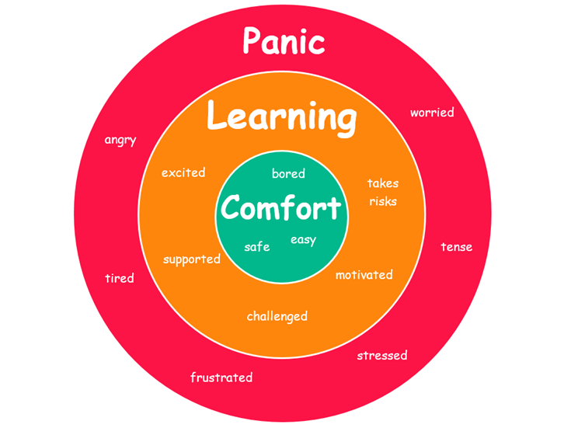
Fixed vs Growth Mindset
Fixed Mindset:
- I can’t do this.
- Avoids challenges.
- Gives up easily.
Growth Mindset:
- I can’t do this yet.
- Embraces challenges.
- Keeps trying.

Slide 7
How Parents and Carers Can Encourage Growth Mindset
Praise effort, not just results.
Support school’s ethos that learning requires effort and new learning will be challenging – that’s how we learn!
Model resilience by sharing your own challenges.
Use 'yet' to encourage learning.

Slide 8
Language That Builds Growth Mindset
Replace 'I’m not good at this' with 'I’ll/ You’ll get better with practice'.
Replace 'This is too hard' with 'Challenges help me/you grow'.
Encourage reflection on effort and strategies.

Slide 9
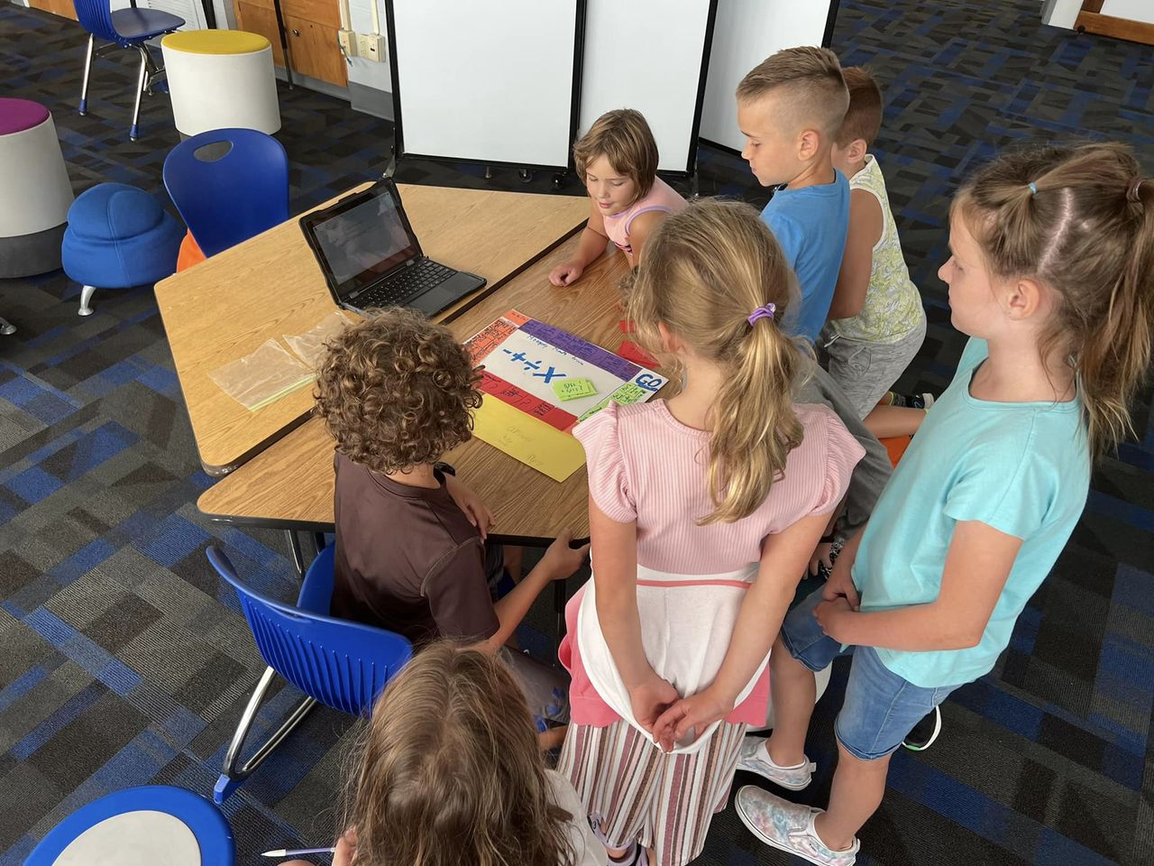

Why Independence Matters
Builds confidence and self-esteem.
Encourages problem-solving and decision-making.
Prepares children for future success in Year 7 and beyond.

Slide 10
Communication and Working together
We encourage children to speak to a school adult if they have a concern or problem. We will ensure any worries are dealt with discreetly, fairly and we also have a ‘Ask It Basket’ in the class if they want to discuss something privately.
We really need your support to help your child and other children in the class have happy and successful learning days at school.
Notes:
Transitions – ring office in advance
Mobile protocol
Use of social media – keeping safe
Permission slips
Home learning optional. It is ARE and practice of skills that have been taught that week. Awarding hard work. If children find the learning challenging, attempt what they can and record in planner what they have completed.

Slide 11
Topics and Events
Term | Topic | Events
Autumn | We’ll Meet Again (WW2) A Taste of Change (Immigration and the Transformation of British Food from 1945 to 2000) | WW2 trip to Take Shelter in Brighton (Wednesday 4th November) VE Day Tea Party in class (Thursday 5th November) Bikeability (week beginning 14th September)
Spring | On the Edge (Survival, Mountains and Evolution) | Residential: MONDAY 15th MARCH – FRIDAY 19th MARCH 2027 Bowles Outdoor Centre
Summer | Groovy Greeks (Historical topic looking at Ancient Greek civilization and its impact) | End of year production Currently Monday 12th July and Tuesday 13th July 2027

Slide 12
National Curriculum Tests
The end of Key Stage 2 Standard Assessment Tests (SATs) are timetabled from Monday 10th May to Thursday 13th May 2027
Below is the timetable for the 2026 KS2 SATs which the 600,000 Year 6 children in England will take.
Monday: Grammar, Punctuation and Spelling
Tuesday: Reading
Wednesday: Maths: Paper 1 - Arithmetic and Paper 2 - Reasoning
Thursday: Maths: Paper 3 – reasoning
These tests assess all Grammar, Maths and Reading with no teacher assessment. Children will be given a scaled score which shows whether they are:
Working Towards the Expected Standard for their age (scaled score of 80-99)
Working at the Expected Standard for their age (scaled score of 100-109)
Working Above the Expected Standard for their age (scaled score of 110-120)

Slide 13
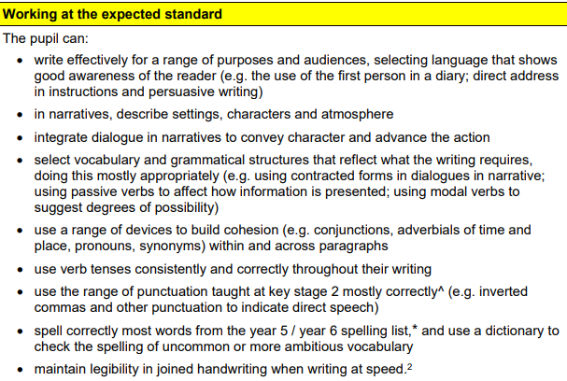
Writing and Science is Teacher/Headteacher assessed and locally moderated.
Here is an example of the criteria for a Year 6 child working at the expected level from the 2019 guidance.

Slide 14
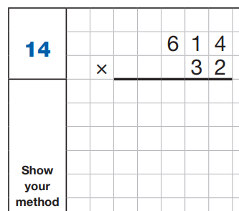
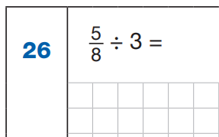
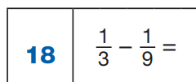
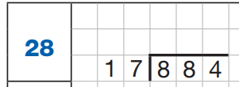
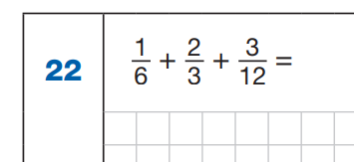
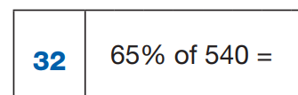

Slide 15
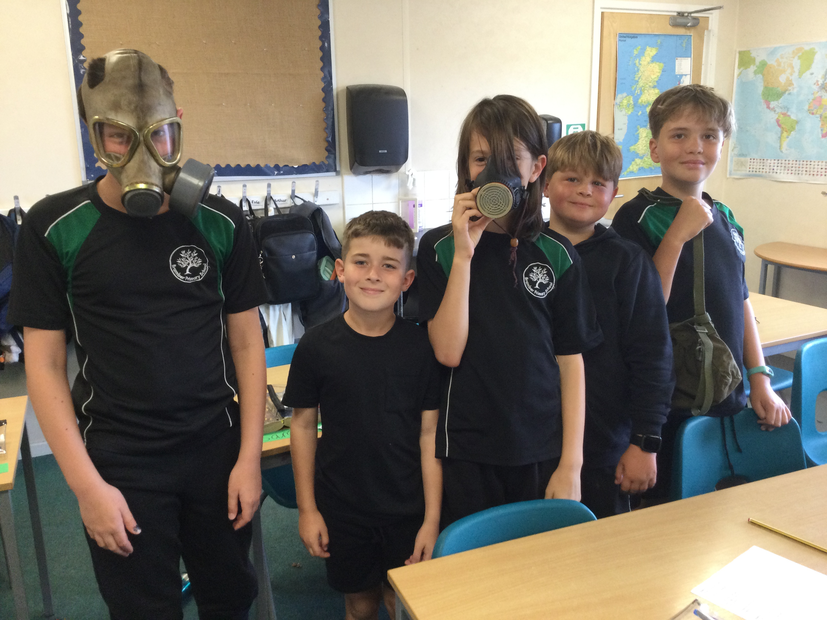
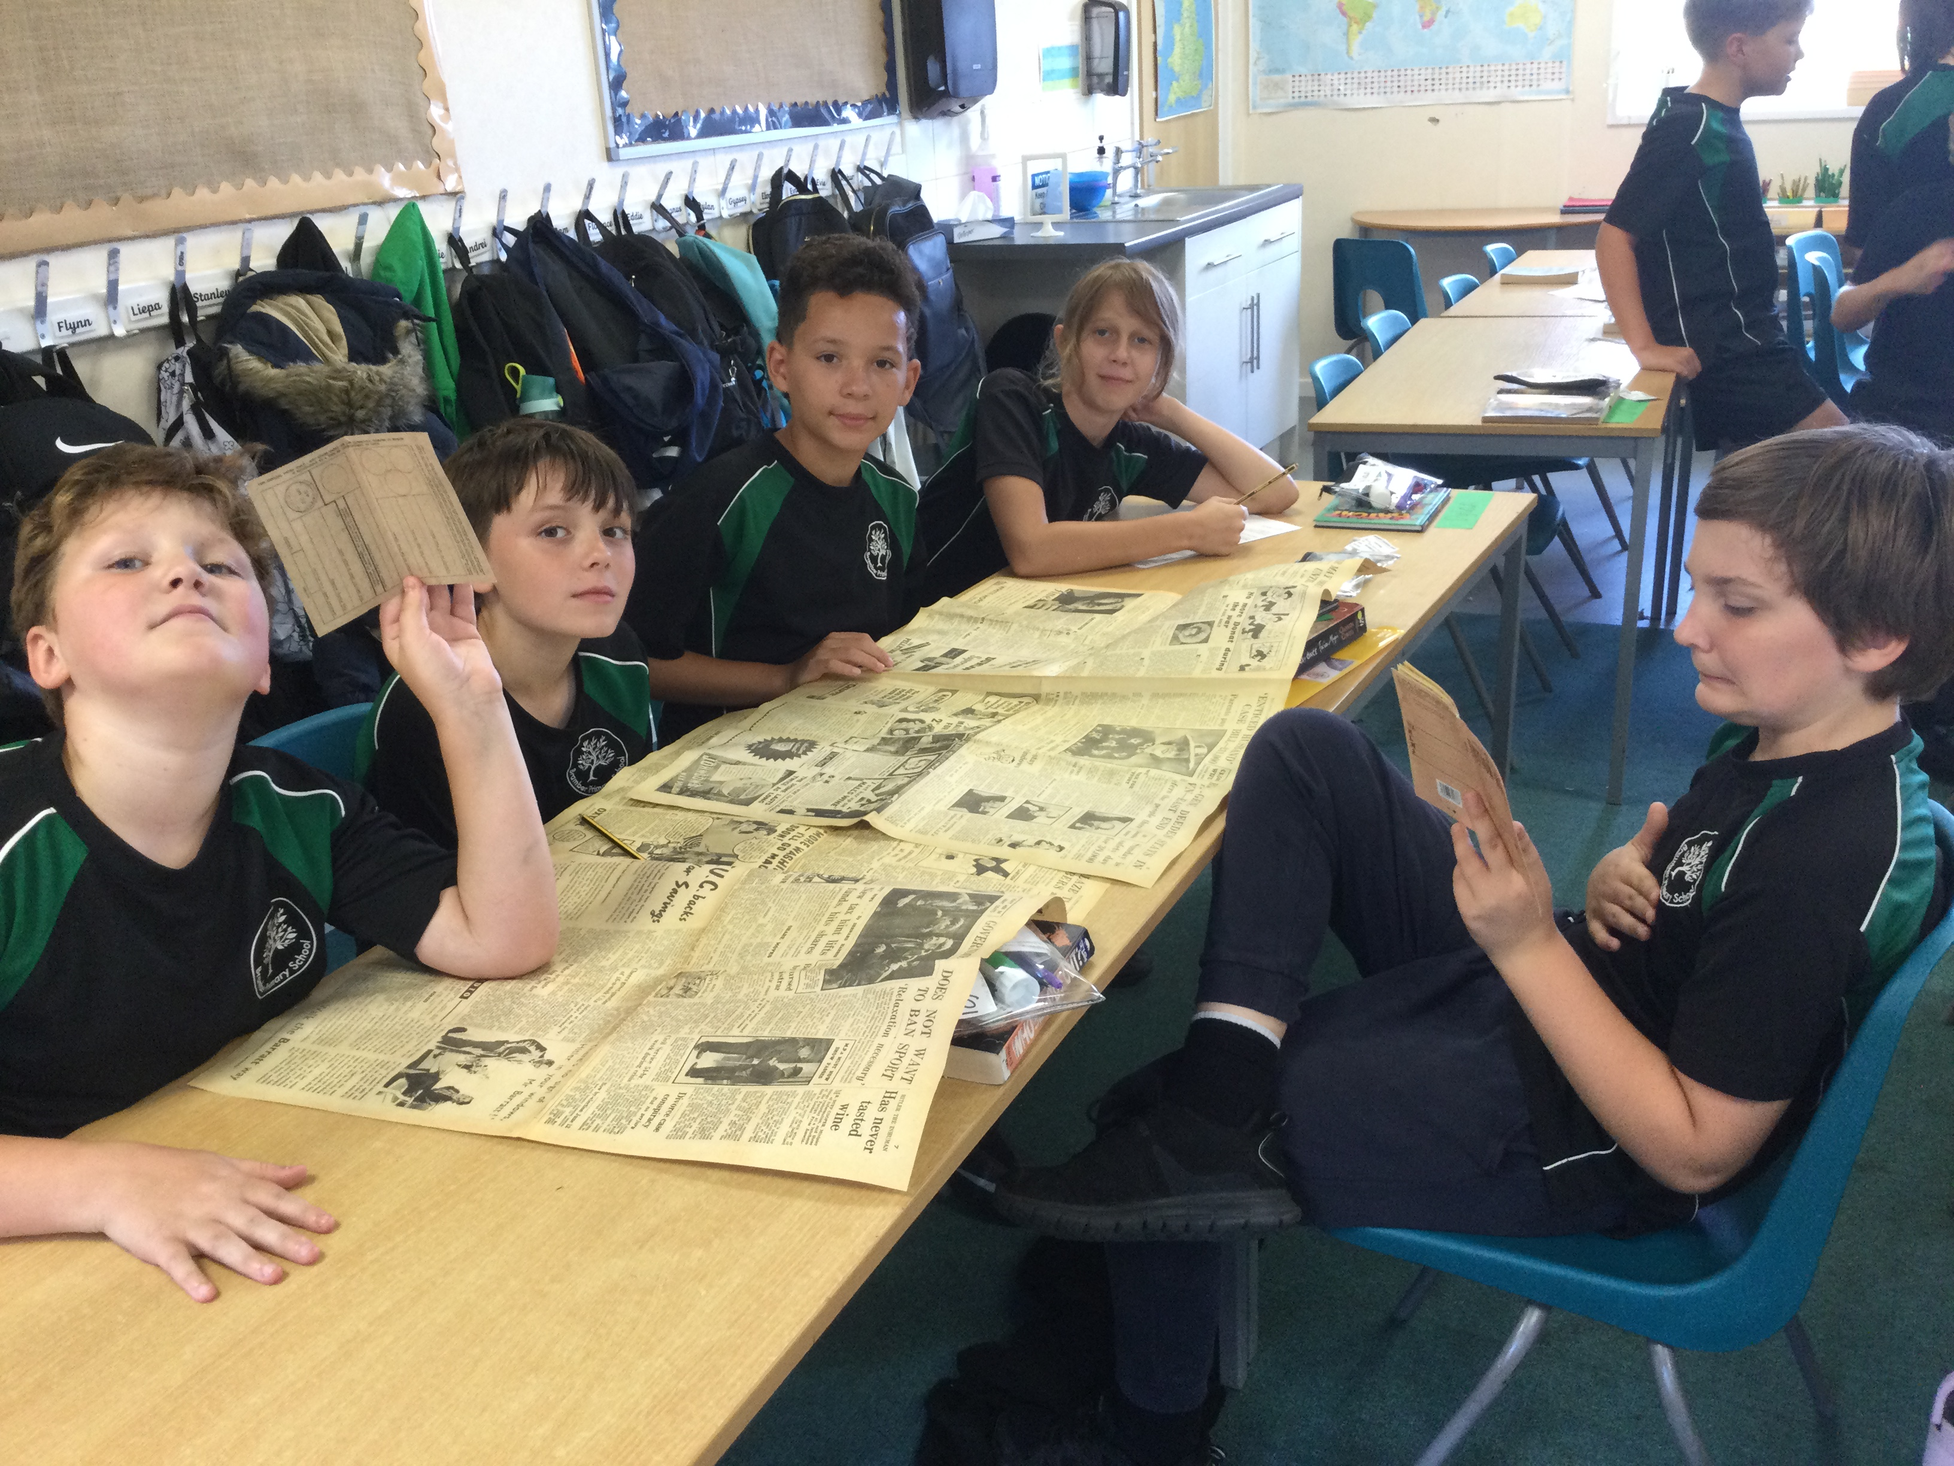
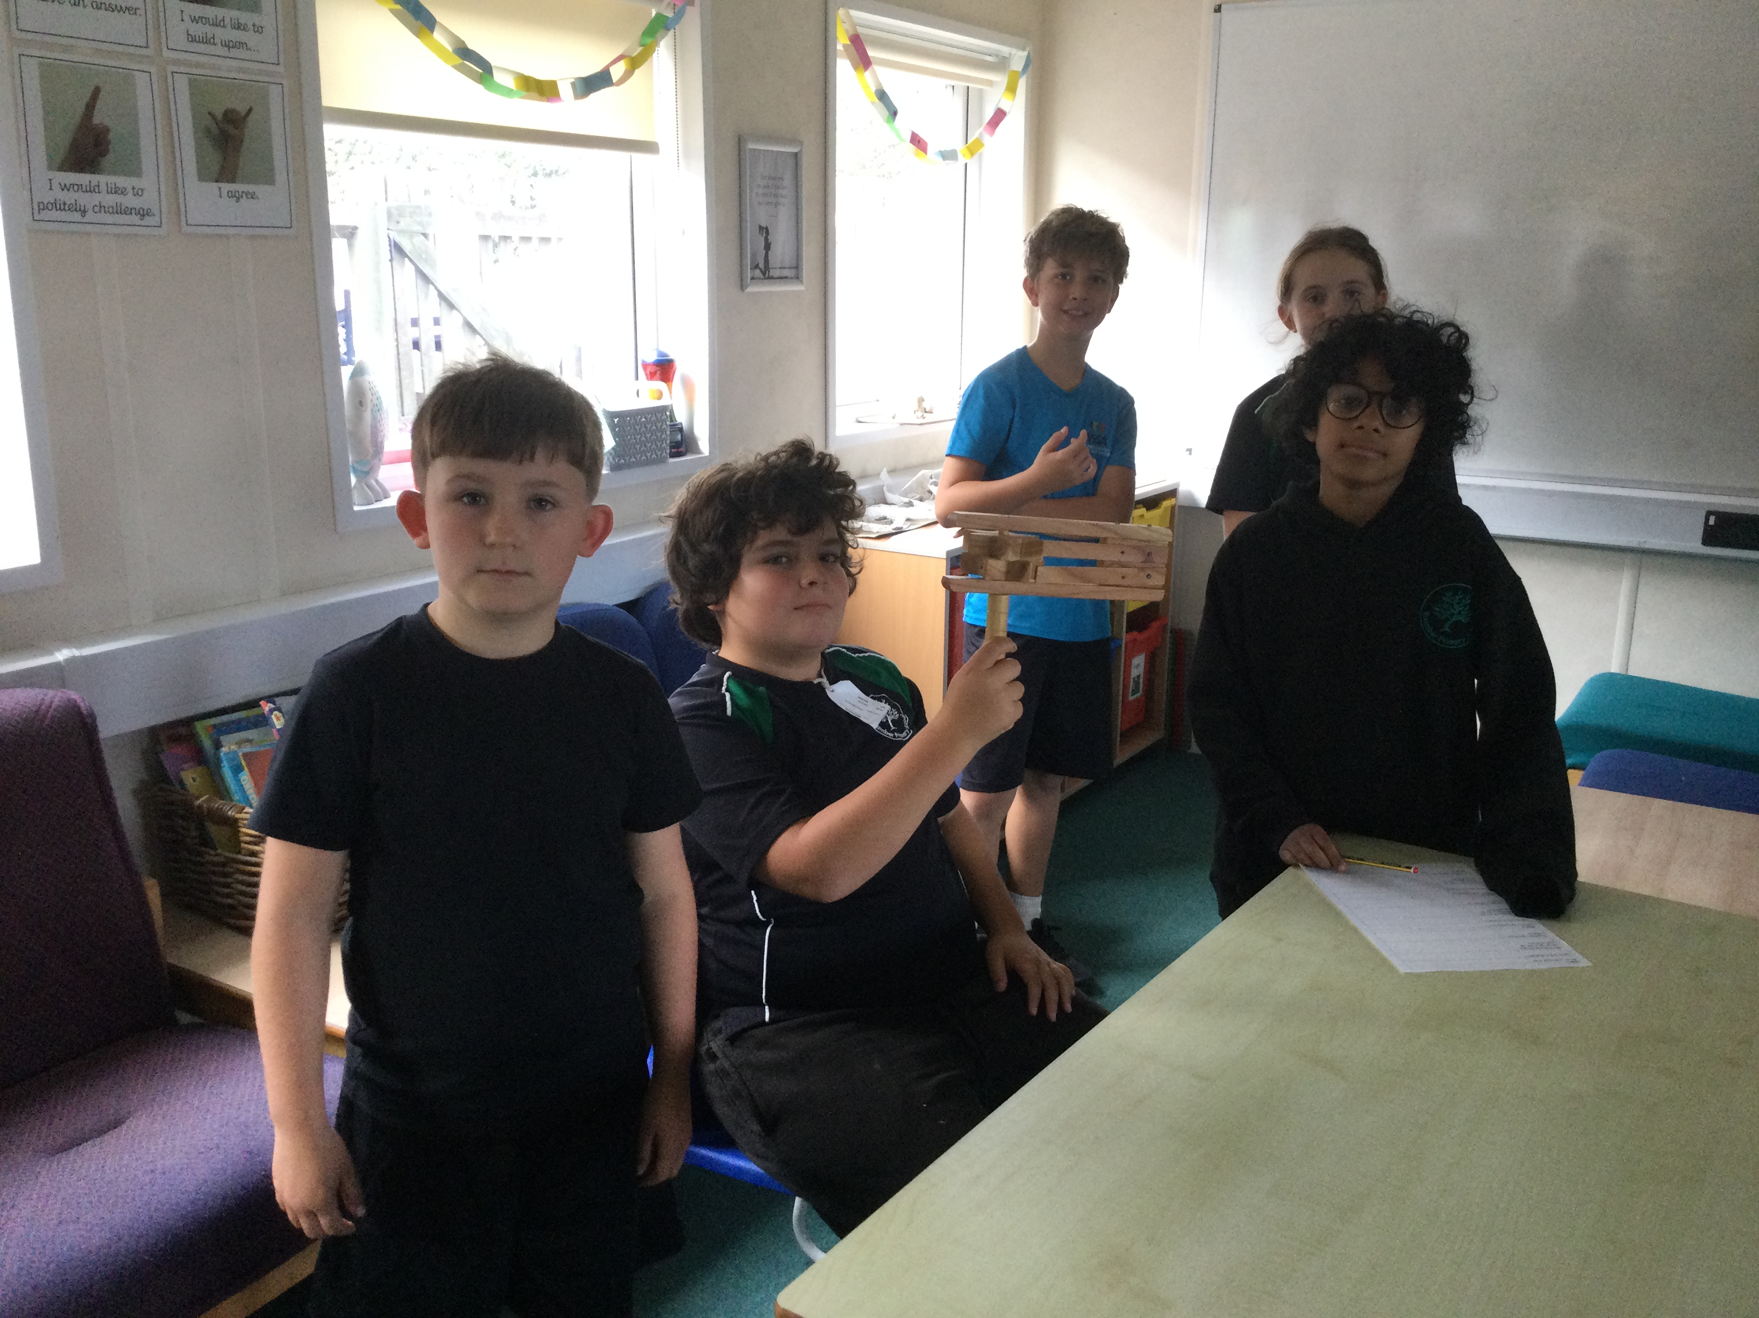
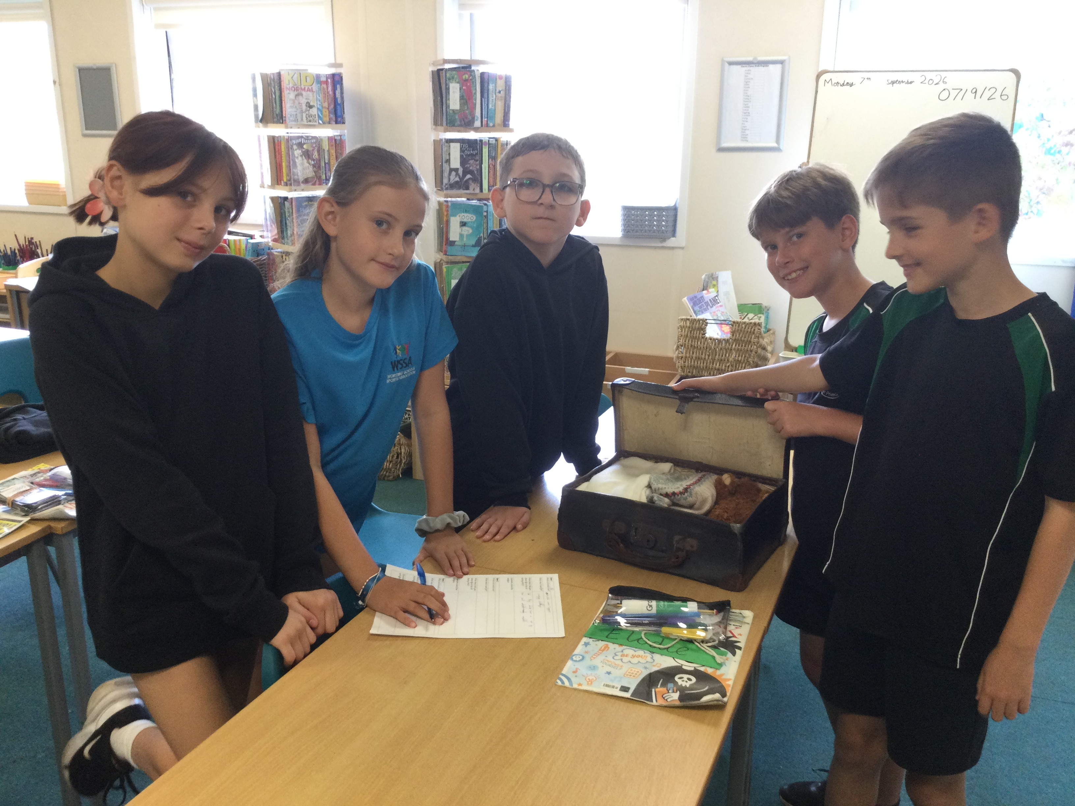
ANY QUESTIONS?

