Slide 1
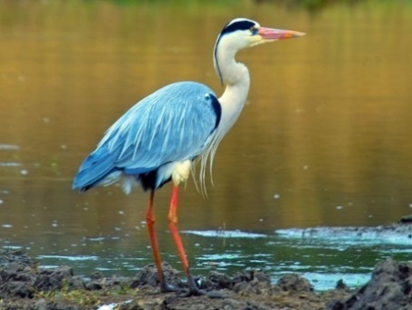
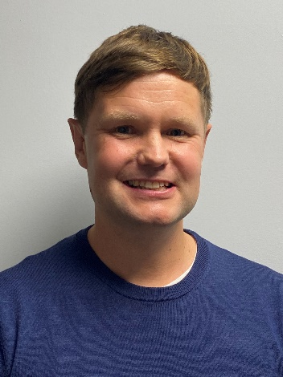
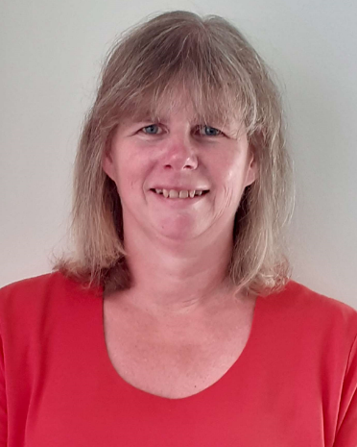
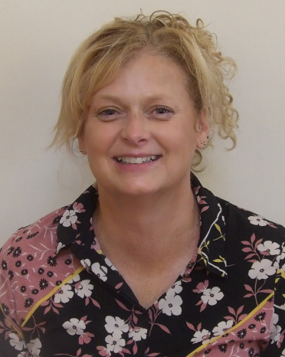
Welcome to Year 6
Class name: Heron
Teacher: Mr Pugh
Teaching Assistants:
Miss Thomson and Mrs Hayes

Slide 2
Roles and Responsibilities.
Lead Learners: Jasmyn and Theo
House Captains:
Parham:
Goodwood:
Petworth:
Stansted:
Legacy Leaders: Evie and Ralph
School Councillors:
Eco Committee:
Art Ambassadors:
Hall Monitors:
Reception Helpers:
Notes:
Other jobs after xmas

Slide 3
Key Information
Bikeability – wb. 9th December
Transitions and applications for Secondary School
Please inform the office of any visits during school time.
Applications for high school by Thursday 31st October 2024.
(Applications are dealt with by the Secondary Schools/High schools and the local authority)
Keeping Safe online
Social media - use advised age rating. Please monitor what they are searching and the messages they send each other.
Age appropriate gaming
Mobile phones – if children have permission to walk to/from school alone, they can be brought into school but must be switched off before they enter the premises. They will then stay in the office which is locked throughout the day. They can turn them on when they have left the school premises.
Notes:
Transitions – ring office in advance
Mobile protocol
Use of social media – keeping safe
Permission slips
Home learning optional. It is ARE and practice of skills that have been taught that week. Awarding hard work. If children find the learning challenging, attempt what they can and record in planner what they have completed.

Slide 4
Key Information
Developing Independence
Walking to and from home without an adult.
Class and who school jobs.
Changing learning partners
Home learning. Homework will be set on Friday and will always include spelling, reading and maths work.
At least 15 minutes daily reading – Accelerated Reader books, books from home and library books
Learning to spell Year 5 and 6 words and learning and applying spelling rules - 5 minutes daily. A weekly spelling list will be sent home to help with this and they are tested weekly on these.
Learning and consolidation of times tables (using TT Rockstars). Their will be a weekly times tables check.
Termly creative tasks, linked to topic learning.
PE
Outdoor and indoor kit on PE days (Monday and Wednesdays). Please remember hair tied or pinned back, no earrings, short nails and a jumper and joggers in colder weather.
Notes:
Transitions – ring office in advance
Mobile protocol
Use of social media – keeping safe
Permission slips
Home learning optional. It is ARE and practice of skills that have been taught that week. Awarding hard work. If children find the learning challenging, attempt what they can and record in planner what they have completed.

Slide 5
Topics and Events
Term | Topic | Events (which may change or be postponed due to the current situation)
Autumn | We’ll Meet Again (WW2) Back in Time for Tea (British history from 1945 to 2000) | WW2 trip tbc. (possibly Thursday 7th November) Bikeability (week beginning 9th December) VE Day Tea Party Millennium Tea Party
Spring | On the Edge (Survival, Mountains and Evolution) | Residential: MONDAY 24th MARCH – FRIDAY 28th MARCH 2024 Bowles Outdoor Centre
Summer | Groovy Greeks (Historical topic looking at Ancient Greek civilization and its impact) | End of year production

Slide 6
National Curriculum Tests
The end of Key Stage 2 Standard Assessment Tests (SATs) are timetabled from Monday 12th May to Thursday 15th May 2025
Below is the timetable from the 2024 KS2 SATs for reference
Monday: Grammar, Spelling and Punctuation
Tuesday: Reading
Wednesday: Maths – Arithmetic and Maths reasoning 1
Thursday: Maths reasoning 2
These tests assess all maths and reading with no teacher assessment.

Slide 7
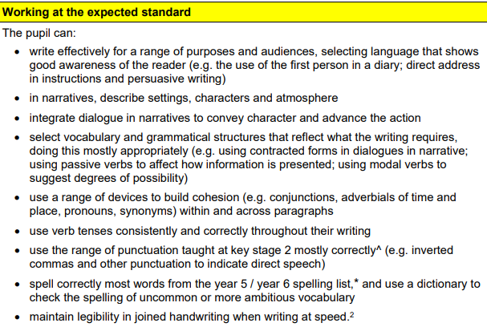
Here is an example of the criteria for a Year 6 child working at the expected level from the 2019 guidance.

Slide 8
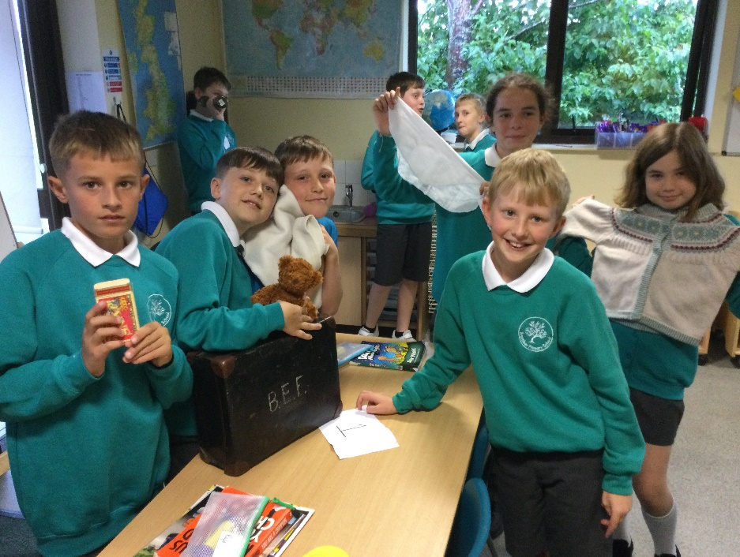
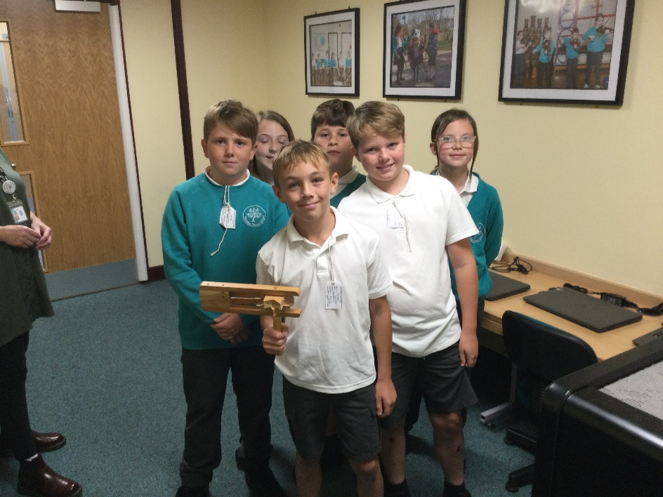
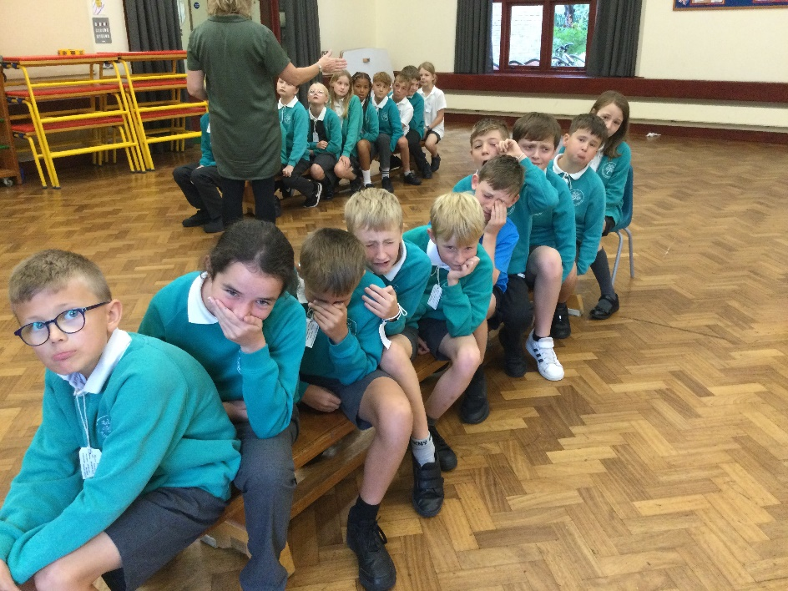
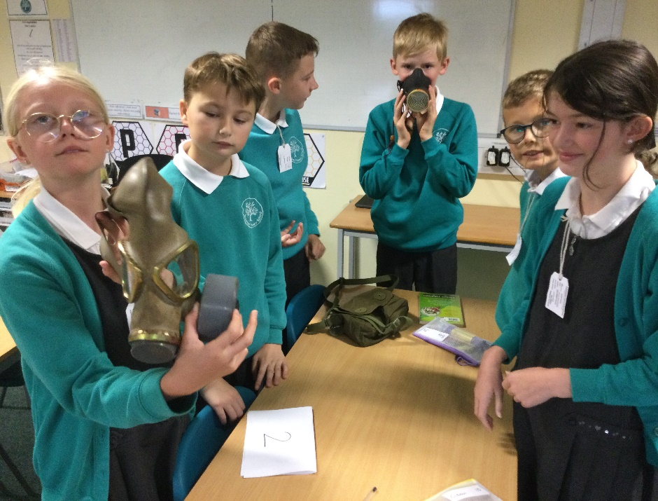
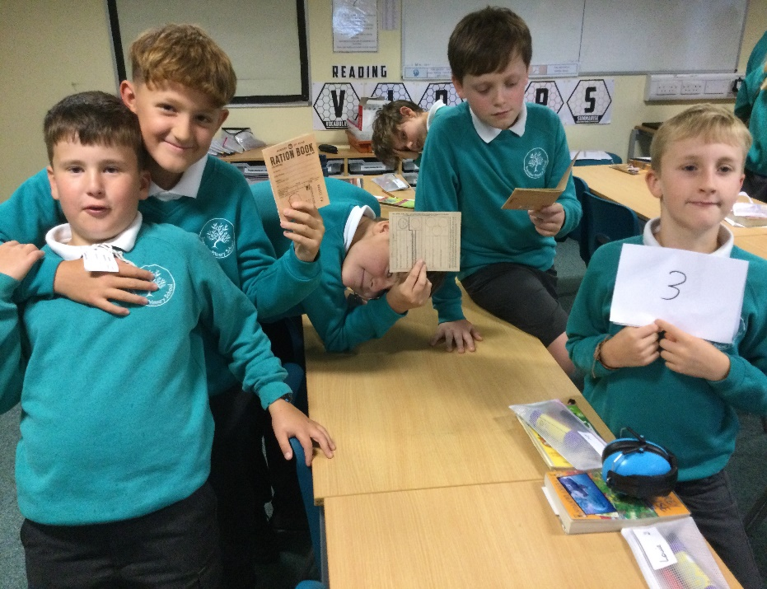
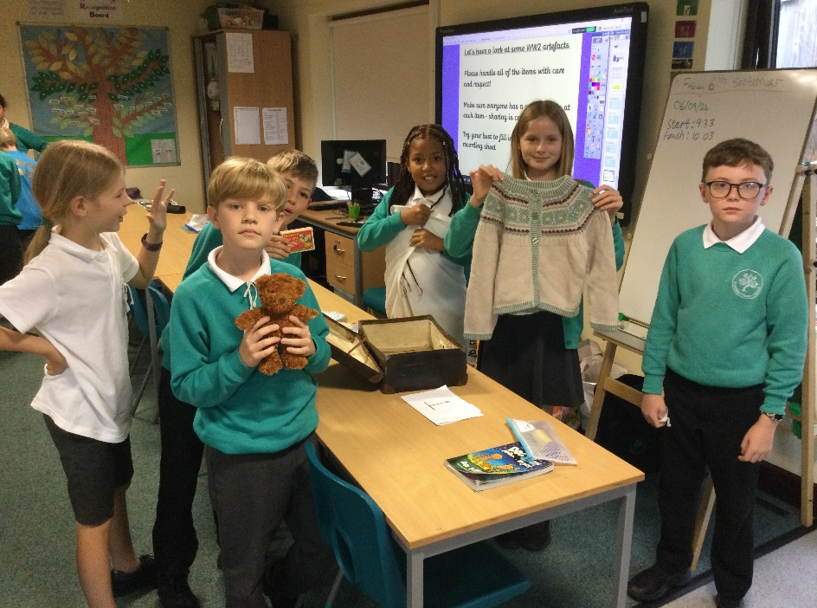
ANY QUESTIONS?

